Slide 1
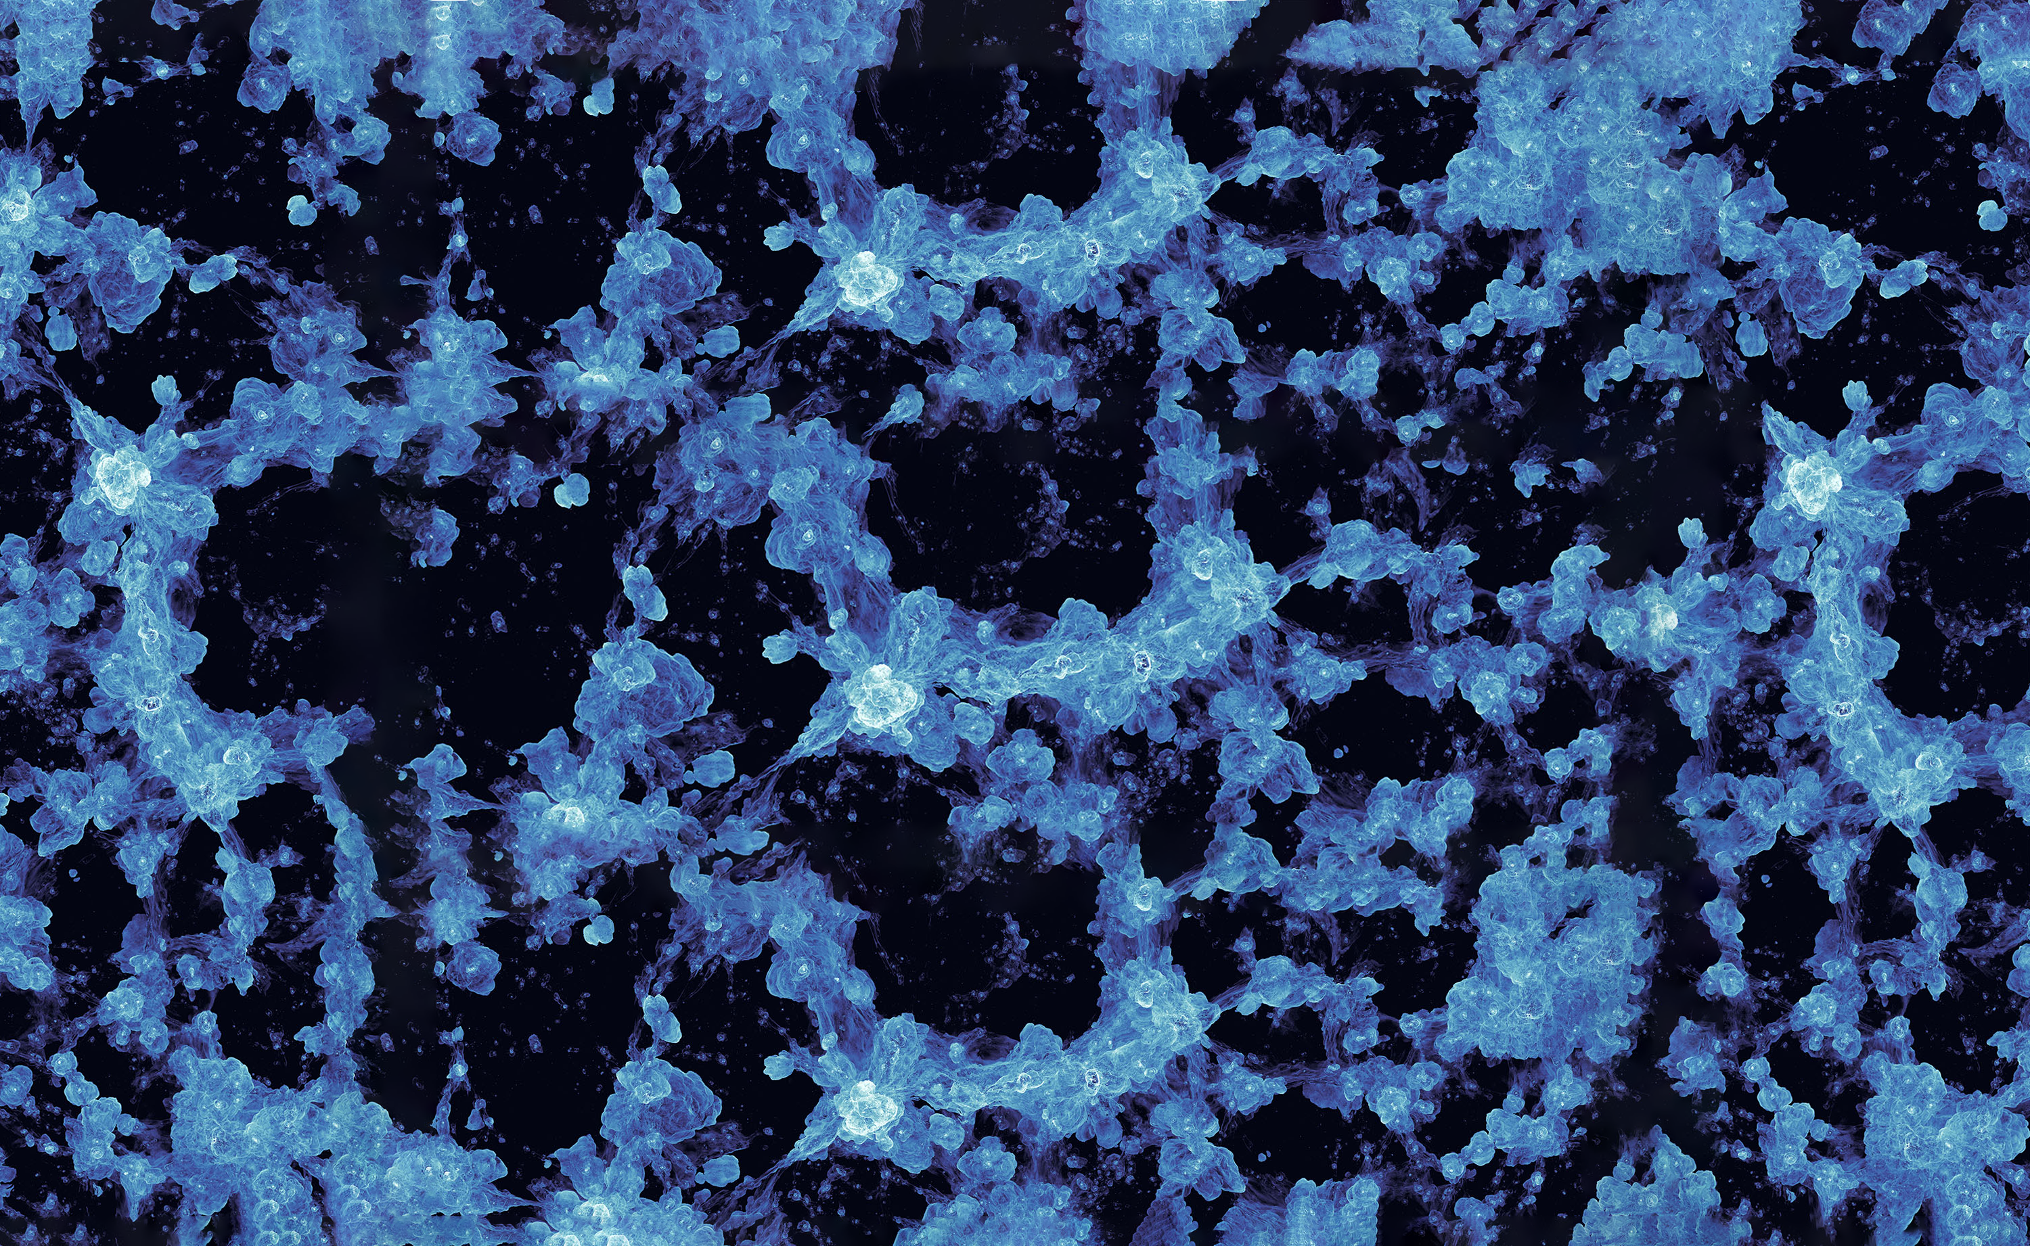

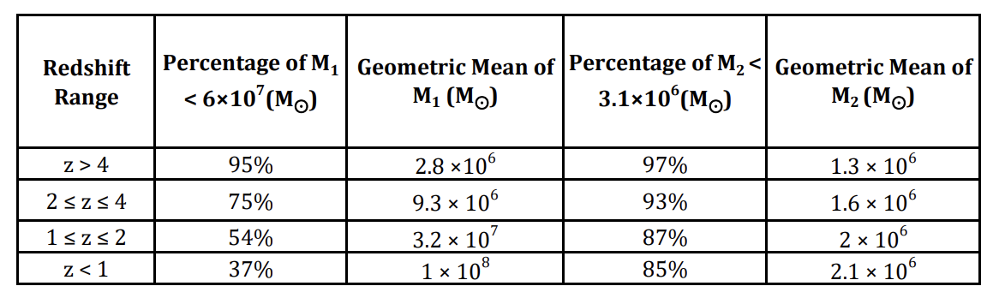
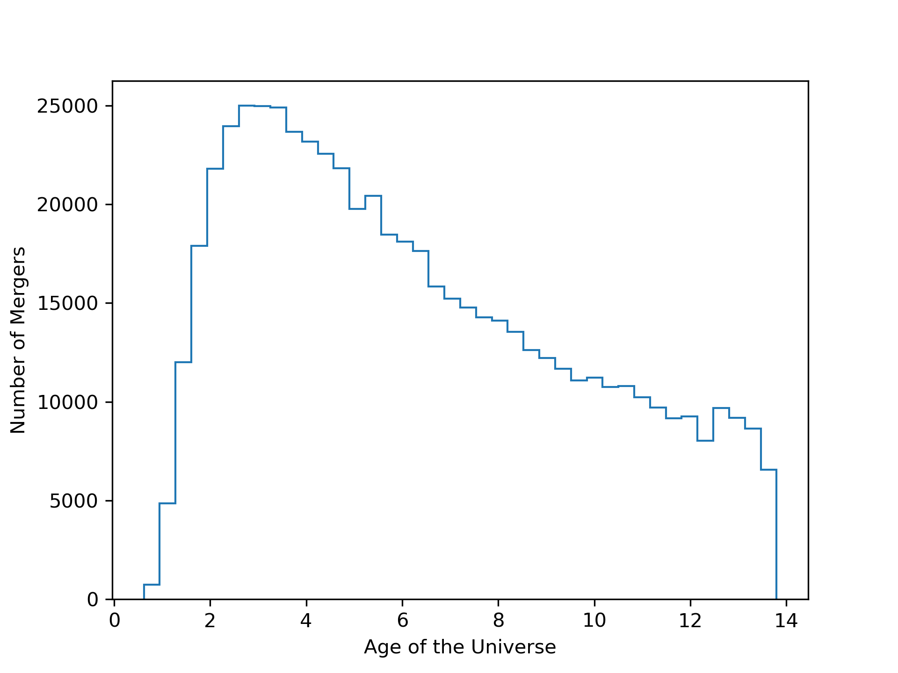
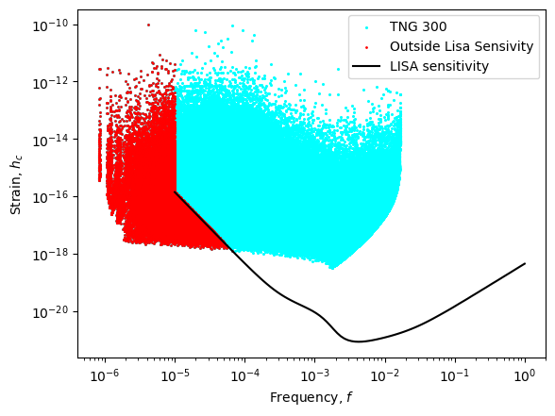
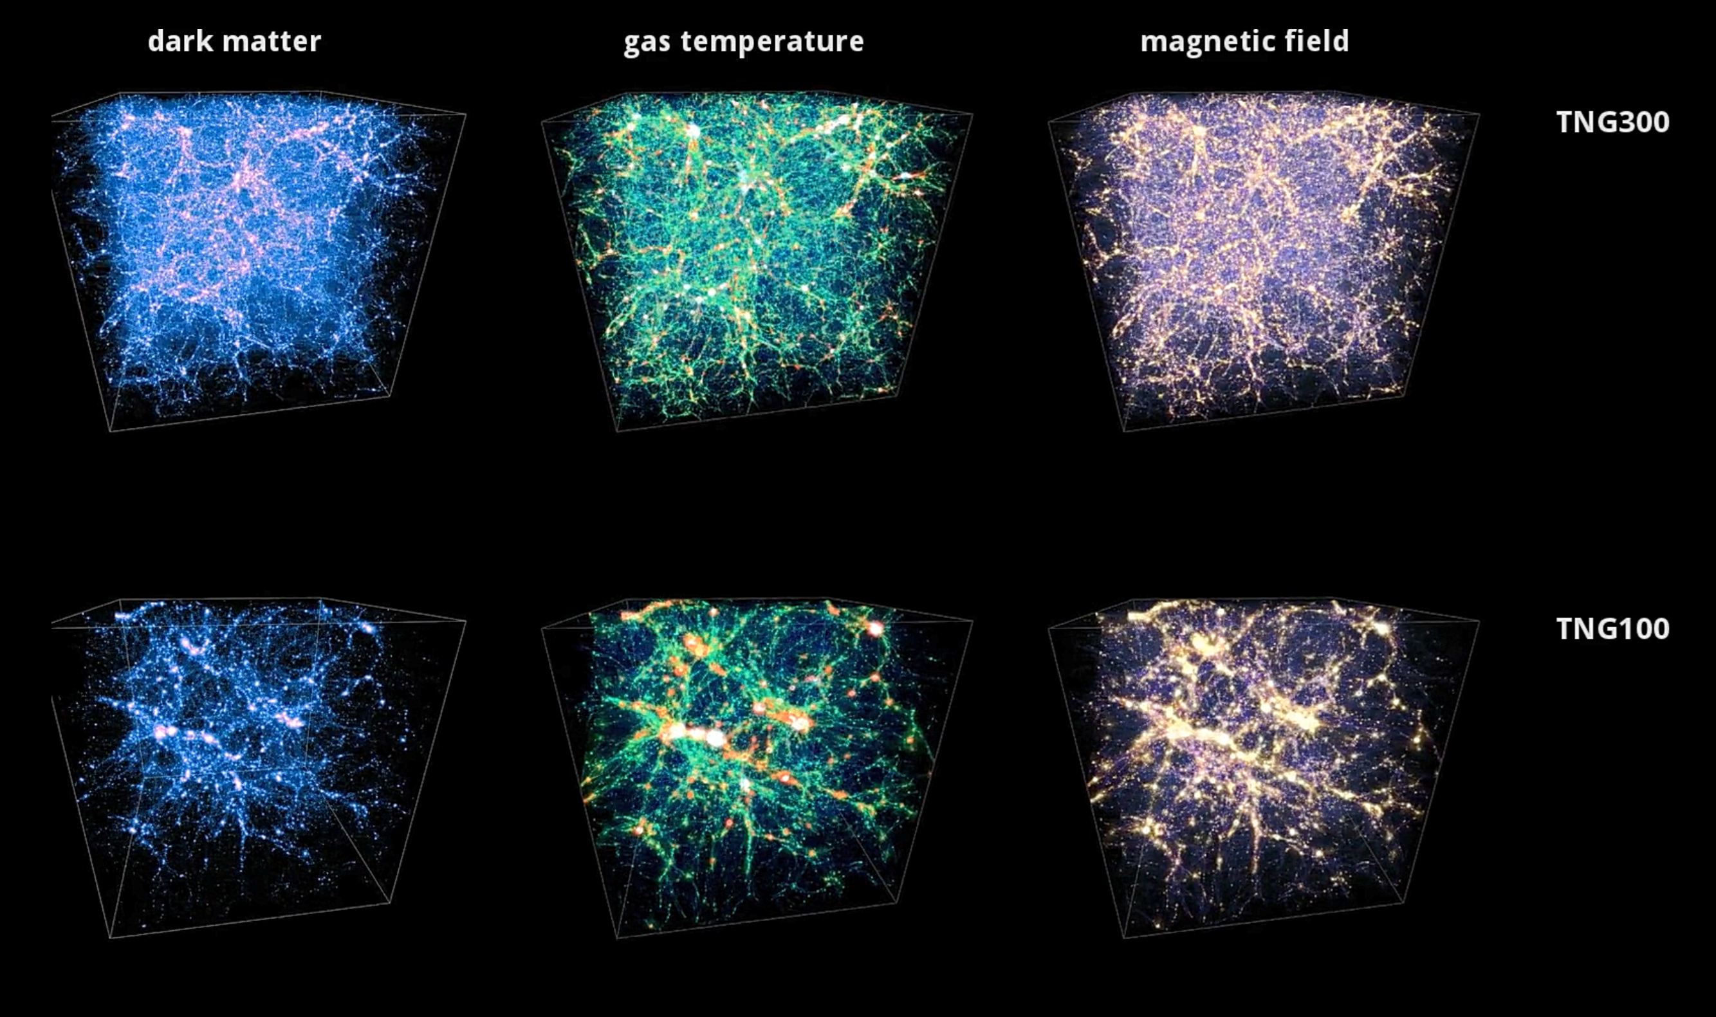
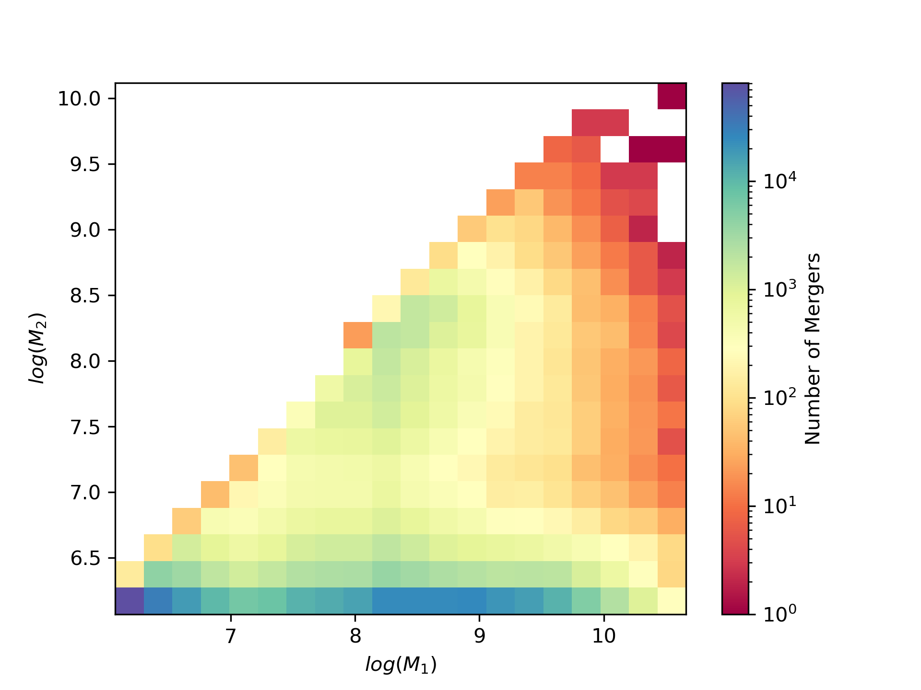
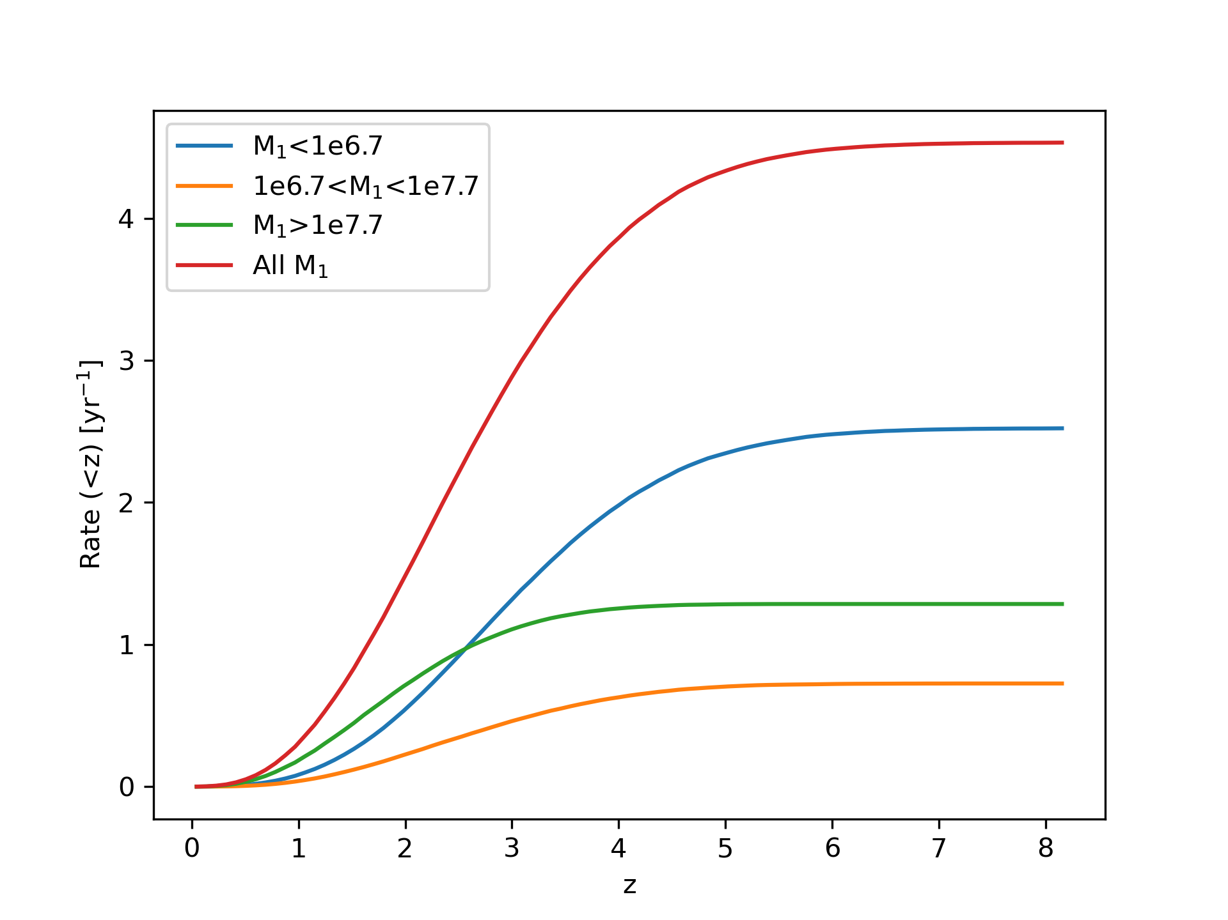
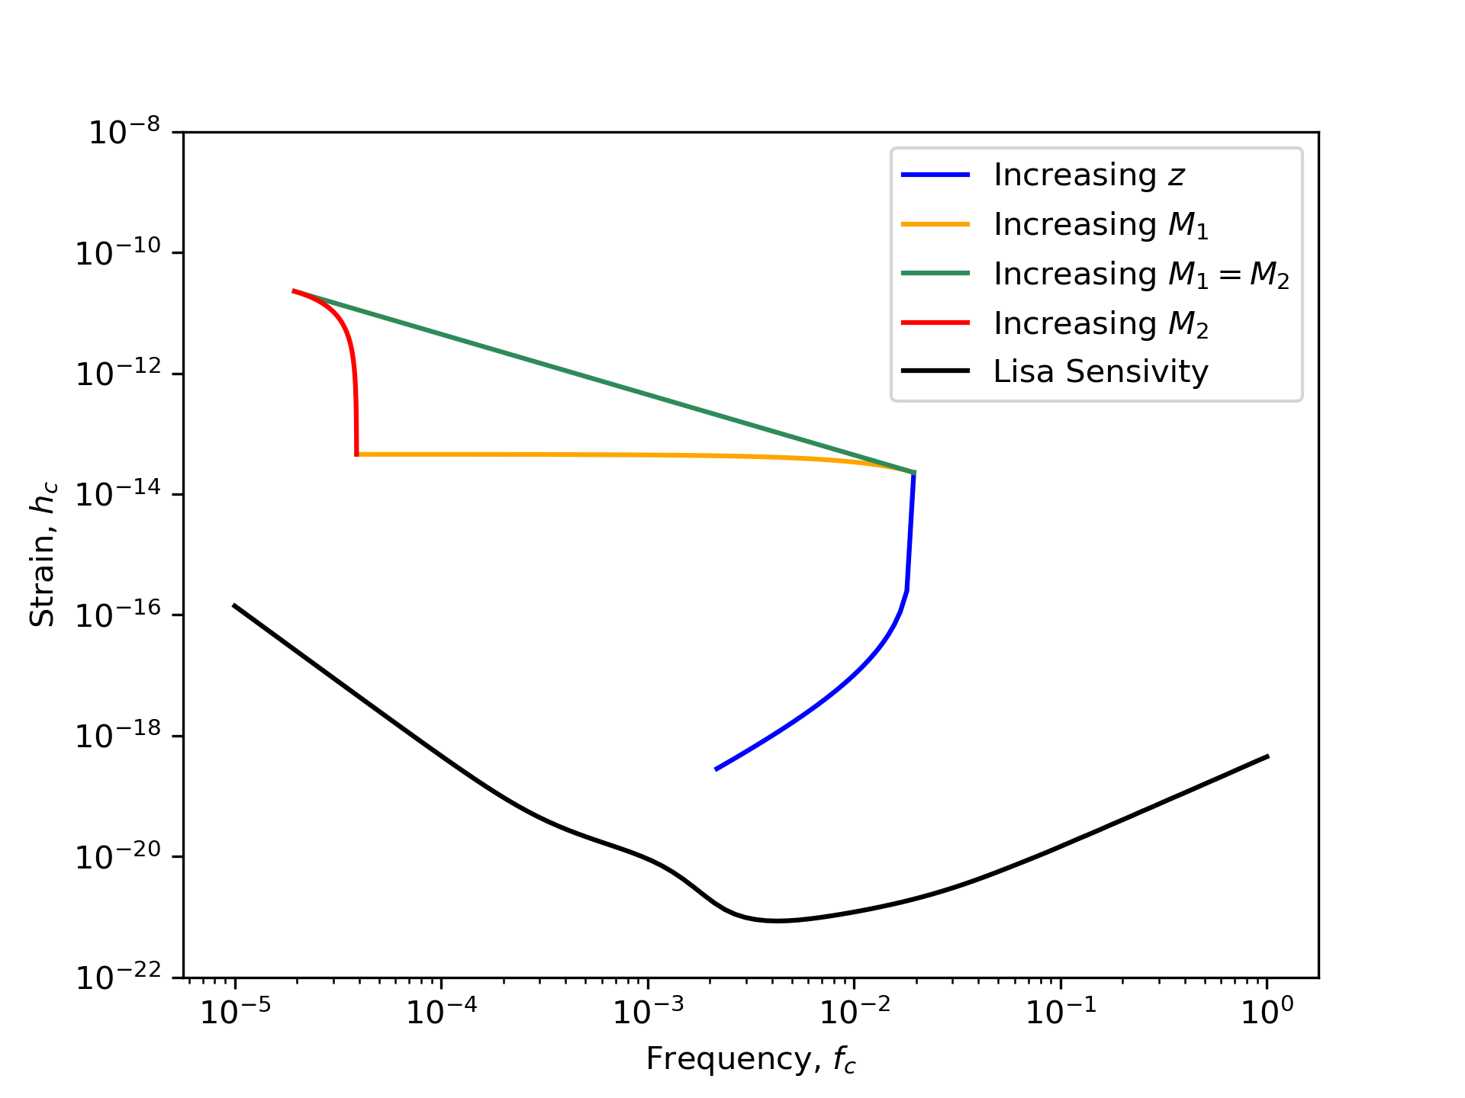

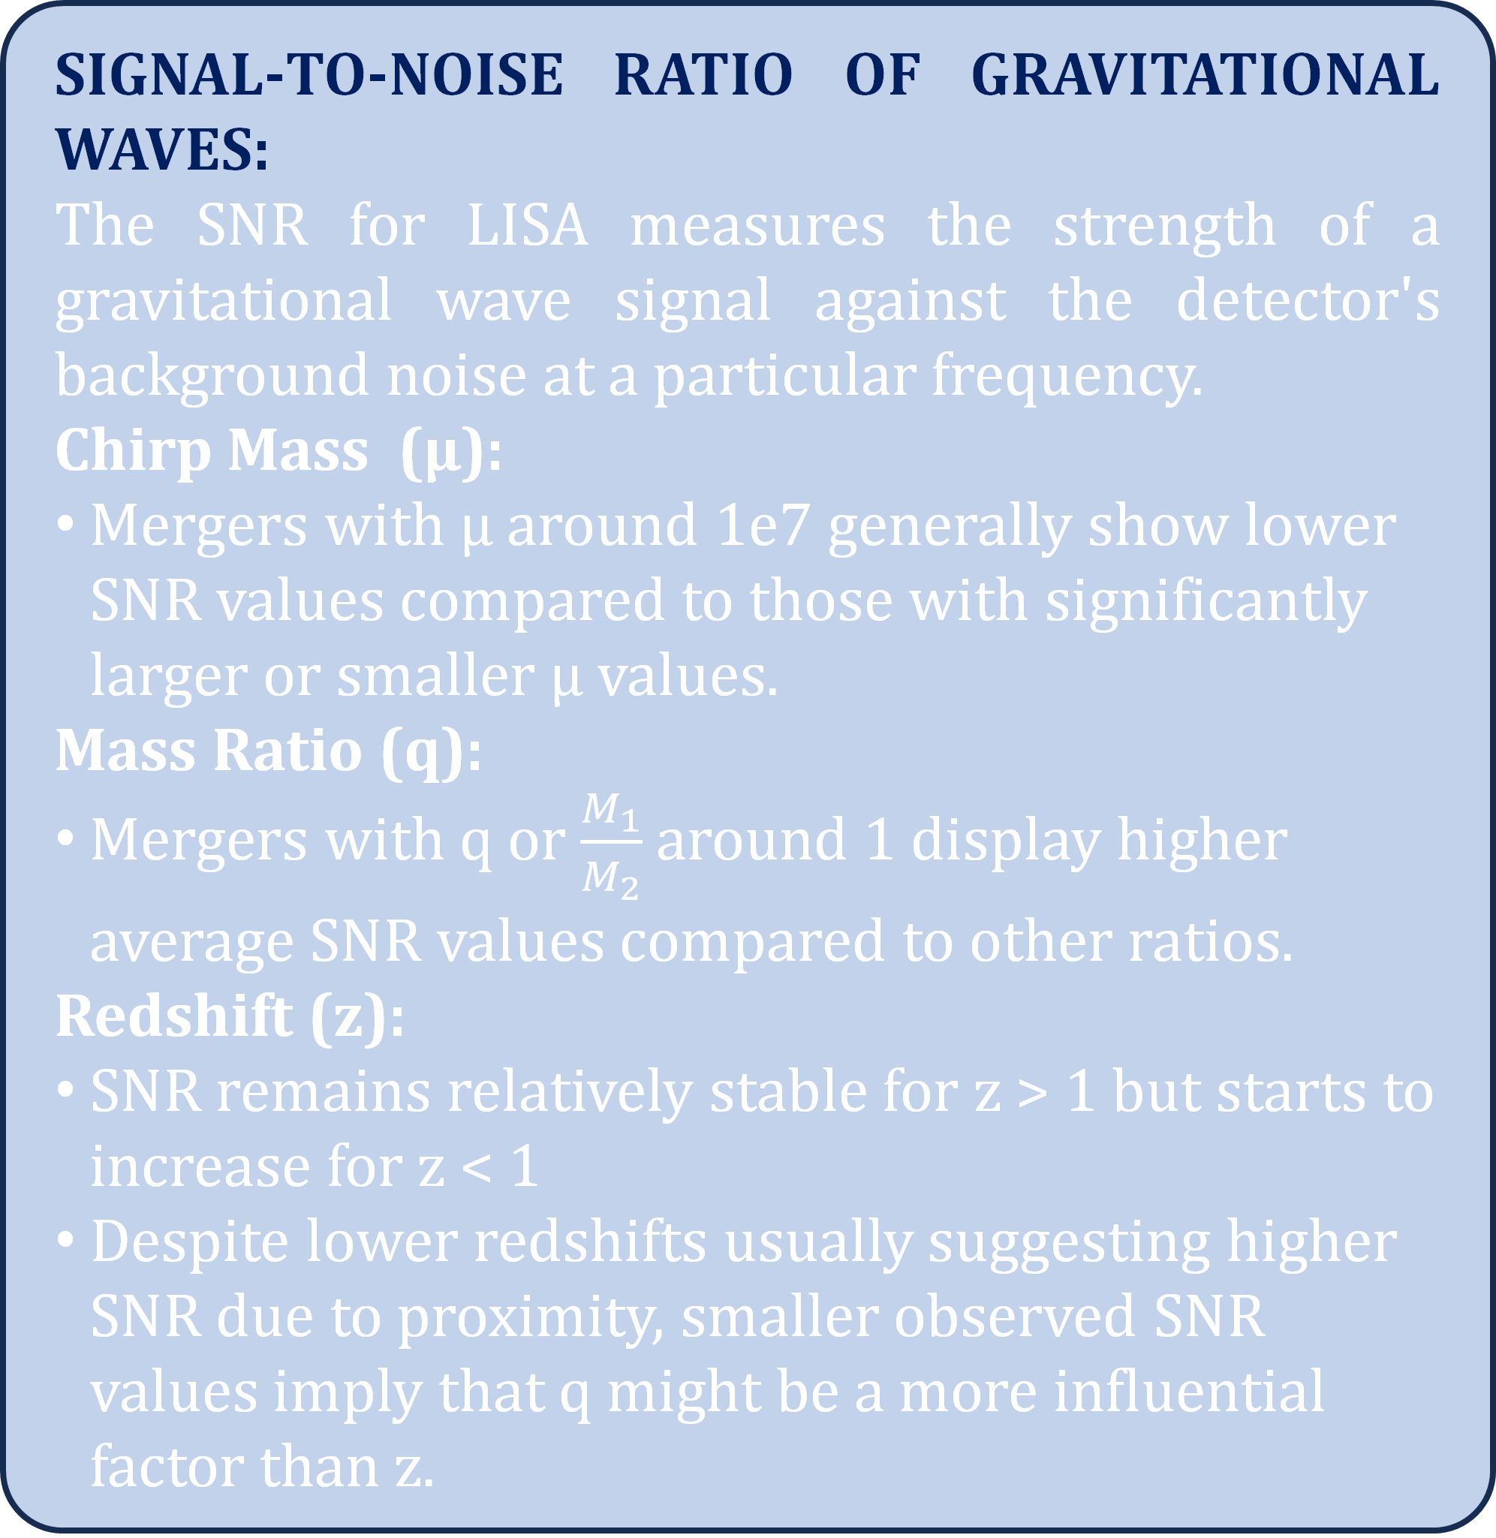

Gravitational Wave Predictions from Supermassive Black Hole Mergers in Cosmological Simulations
Thirtha Karmakar, Dr. Colin DeGraf
Truman State University, Kirksville, MO-63501.
MOTIVATION:
Supermassive black holes are found at the center of galaxies and play an important role in the evolution of galaxies. Since the first LIGO detection, gravitational waves (GW) have become an area of increasing interest, and with the upcoming LISA mission it is important to characterize the relationship between merging black hole properties and the gravitational wave signals we expect LISA to detect. In this project, we generate catalogs of black hole mergers and their associated gravitational wave signals. We use these catalogs to predict GW signals received by LISA and the physical phenomena which produced them.
BLACKHOLE MERGER CHARACTERISTICS
Redshift & Time Dependency:
More mergers occur at low redshift (z) than at high redshift. 77% of mergers happened at z < 2.
Mergers in the early universe happen at a slower rate, peaking at ~3 billion years after the big bang, and then decreasing until the current time
Table 1: Mass Distribution of merging black holes
SIGNAL-TO-NOISE RATIO OF GRAVITATIONAL WAVES:
The SNR for LISA measures the strength of a gravitational wave signal against the detector's background noise at a particular frequency.
Chirp Mass (µ):
Mergers with µ around 1e7 generally show lower SNR values compared to those with significantly larger or smaller µ values.
Mass Ratio (q):
Mergers with q or $\frac{M_{1}}{M_{2}}$ around 1 display higher average SNR values compared to other ratios.
Redshift (z):
SNR remains relatively stable for z > 1 but starts to increase for z < 1
Despite lower redshifts usually suggesting higher SNR due to proximity, smaller observed SNR values imply that q might be a more influential factor than z.
LISA-DETECTION FREQUENCY AND STRAIN:
SIMULATION DETAILS:
The IllustrisTNG project is a set of publicly available simulations of our universe, starting from the very early universe (<20 million years after the big bang) and continuing until the modern day. The TNG project includes 20 simulations, with varying physical size, resolution, and physics models included. These simulations model gravitational, hydrodynamical, and magnetic interactions of matter in the universe, as well as star formation and feedback, chemical makeup of gas, and black hole interactions, with a goal of better understanding how galaxy formation works. Of particular importance to us, the black holes and galaxy properties generated from the simulation have been compared to what we can observe in the real universe.
Figure 2: Number of Mergers with respect to the Age Of the Universe. Each bin here represents around 325 million years.
Figure 4: Predicted frequency and strain for BH mergers (colored datapoints), compared to the LISA sensitivity curve (black)
GRAVITATION WAVE DETECTION PREDICTION:
Greater than 4 mergers/year
Greater than 2 Low Mass (M₁ < 10^{6.7} M⊙) mergers/year.
Less than 1 Moderate Mass (10^{6.7} < M₁ < 10^{7.7} M⊙): < 1 mergers/year
Around 1 High Mass (M₁ > 10^{7.7} M⊙) mergers/year.
Parameter dependence of Strain (h_{c}) & Frequency(f_{c}):
Effect of z:
Strain decreases with increasing z, while frequency decreases at the highest redshifts
Impact of M₁ and M₂
Increasing primary mass (M₁) significantly decreases f_{c}.
Increasing secondary mass (M₂) primarily increases h_{c}, while f_{c} decreases once M₂ approaches M_{1.}
Mass Dependency:
High-redshift (z > 6) shows mostly low-mass (M₁ & M₂<10^{6.5} M⊙ mergers; moderate redshift (2-6) features primarily low-mass mergers but includes higher masses; low-redshift (z < 2) is characterized by mostly larger mass mergers.
Figure 1: Full simulation cubes of TNG300 (on the top) and TNG100 (on the bottom), showing dark matter, gas temperature, and magnetic field strength, all at the present day (z=0) credit: TNG Simulations
Figure 3: 2d Histogram of log(M₁) & log(M₂) color-coded with number of mergers.
Figure 4: Parameter dependence of Strain (h_{c}) & Frequency (f_{c} )
Figure 5: Rate at which GWs reach Earth, binned by M₁

